Slide 1
Writing small numbers in standard form
Task A: Writing very small numbers in standard form
Using the place value charts, write the following in standard form.
a)
O
t
h
th
tth
hth
0 | 0 | 0 | 0 | 6 | 9
10⁰
10⁻¹
10⁻²
10⁻³
10⁻⁴
10⁻⁵
b)
6.9 × 10⁻⁴
O
t
h
th
tth
hth
0 | 0 | 1 | 2 | 8
10⁰
10⁻¹
10⁻²
10⁻³
10⁻⁴
10⁻⁵
1.28 × 10⁻²
2) Which of the following are not in standard form? Explain why.
a) 123 × 10⁻⁹
b) 1.24 × 10⁻³
c) 0.96 × 10⁻¹
d) 12 300 ÷ 10¹⁰
e) 0.059 × 10⁸
This is incorrect as 123 needs to be a number satisfying 1 ≤ A < 10
This is in correct standard form
This is incorrect as 0.96 needs to be a number satisfying 1 ≤ A < 10
This is incorrect as standard form uses multiplication.
This is incorrect as 0.059 needs to be a number satisfying 1 ≤ A < 10
3) Without a place value chart, write the following in standard form.
0.000 000 354
0.001 45
0.000 000 000 563
0.048 6
0.000 000 000 631
= 3.54 × 10⁻⁷
= 1.45 × 10⁻³
= 5.63 × 10⁻¹⁰
= 4.86 × 10⁻²
= 6.31 × 10⁻¹⁰

Slide 2
Writing small numbers in standard form
Task B: Converting between ordinary and standard form
Convert the following into standard form.
0.000 000 263
652 000 000
0.005 63
892 000 000 000
0.000 000 000 000 0003
30 004 000
0.000 300 4
= 2.63 × 10⁻⁷
= 6.52 × 10⁸
= 5.63 × 10⁻³
= 8.92 × 10¹¹
= 3 × 10⁻¹⁶
= 3.0004 × 10⁷
= 3.004 × 10⁻⁴
2) Convert the following into ordinary numbers.
2.31 × 10⁴
6.153 × 10⁻⁵
9.1565 × 10⁻⁶
2.48 × 10⁵
2.48 × 10⁻⁵
3.0065 × 10⁻⁹
= 23 100
= 0.000 061 53
= 0.000 009 156 5
= 248 000
= 0.000 024 8
= 0.000 000 003 006 5
3) A microchip has a width of 2 × 10⁻⁶ m. Write this as an ordinary number in cm.
4) Mars is approximately 225 million km away from Earth. Write this in standard form in m.
5) The radius of an atom is approximately 1 × 10⁻¹⁰ m. Write this an an ordinary number in mm.
0.000 002 m = 0.000 000 02 cm
225 000 000 km = 225 000 000 000 m =2.25 × 10¹¹ m
0.000 000 000 1 m = 0.000 000 000 000 1 mm

Slide 3
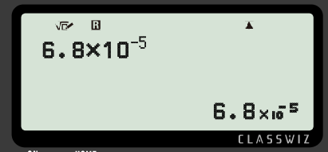
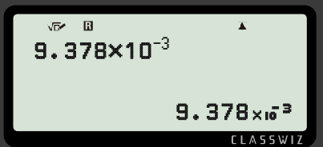
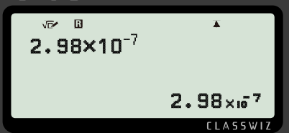
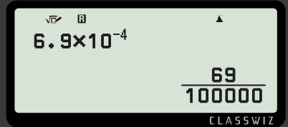
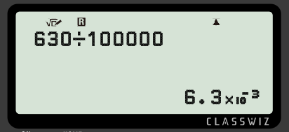
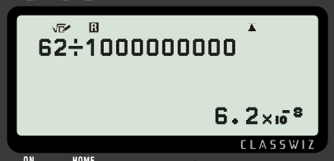
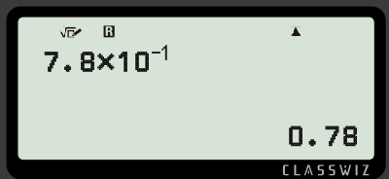
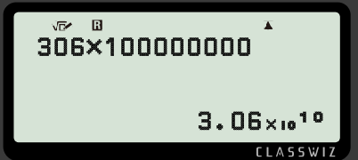
Writing small numbers in standard form
Task C: Standard form on the calculator
Write the output as a decimal.
a)
c)
0.000 068
0.009 378
b)
d)
0.000 000 298
0.000 69
2) Investigate when the number becomes so small that the calculator converts it into standard form.
Any number when written in standard form has an exponent less than or equal to −3
3) Fill in the missing information.
a)
c)
b)
d)
Mathematics in Education and Industry
v2.3

